Slide 1


SOFTWARE Design & Analysis (Week-15)
Usama Musharaf
MS-CS (Software Engineering)
Lecturer (Department of Computer Science)
FAST-NUCES Peshawar

Slide 2
Week # 15
Design Patterns

Slide 3
Software Design Patterns

Slide 4
Introduction to design patterns
A good design is more than just knowing and applying OO concepts like abstraction, inheritance, and polymorphism.
Designers focuses on creating flexible designs that are more maintainable and that can cope with changes easily.

Slide 5




How Patterns are used
Designer
Design Problem.
Solution.
Implementation details.
Programmer
Reduce gap
Design
Implementation

Slide 6
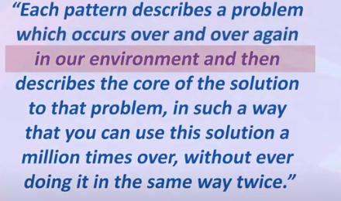
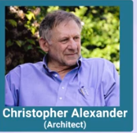
Pattern

Slide 7
Pattern
A Pattern must:
Solve a problem and be useful.
Have a context and can describe where the solution can be used.
Recur in relevant situations.
Provide sufficient understanding to tailor the solution.

Slide 8
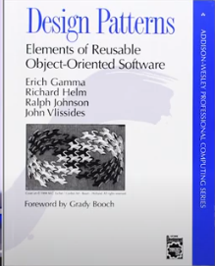
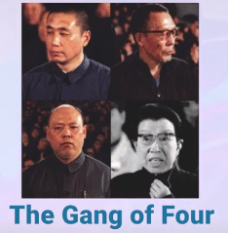
Gang of four

Slide 9
Elements of Design Pattern

Slide 10
Elements of design pattern
Design patterns have four essential elements:
Pattern name
Problem
Solution
Consequences

Slide 11
Design pattern vs Framework
Pattern | Framework
Design patterns are recurring solutions to the problems that arise during the life of a software application in a particular context. | A frame work is a group of components that cooperate with each other to provide a reusable architecture.
Primary Goal | Primary Goal
Improves quality of the software in terms of the software being reusable, maintainable, extensible etc. Reduces development time | Improves quality of the software in terms of the software being reusable, maintainable, extensible etc. Reduces development time

Slide 12
Design pattern vs Framework
Pattern | Framework
Patterns are logical in nature. | Frameworks are more physical in nature as they exist in the form of software.
Independent of programming language and implementation. | Implementation Specific.
Patterns provide a way to do good design and are used to help design frameworks. | Design patterns may be used in the design and implementation of a framework.

Slide 13
Categories of Design Pattern

Slide 14
Categories of design pattern
This book defined 23 patterns in three categories
Creational patterns deal with the process of initializing and configuring of classes and objects (5)
Structural patterns, deal primarily with the static composition and structure of classes and objects (7)
Behavioral patterns, which deal primarily with dynamic interaction among classes and objects (11)
How they distribute responsibility

Slide 15
GoF Patterns
Creational Patterns
Abstract Factory
Builder
Factory Method
Prototype
Singleton
Structural Patterns
Adapter
Bridge
Composite
Decorator
Façade
Flyweight
Proxy
Behavioral Patterns
Chain of Responsibility
Command
Interpreter
Iterator
Mediator
Memento
Observer
State
Strategy
Template Method
Visitor

Slide 16
Limitations of design pattern
Patterns do not lead to direct code reuse.
Patterns are deceptively simple.
Patterns are validated by experienced rather than by automated testing.
Integrating patterns into a software development process is a human intensive activity.

Slide 17
Singleton Design Pattern (creational pattern)

Slide 18
Singleton Design Pattern
Sometimes there may be a need to have one and only one instance of a given class during the lifetime of an application.
Eg. Database Connection
Singleton Design Pattern ensures that there is only one instance of a class and provides global point of access to it.

Slide 19
Code for Singleton Design Pattern
public class Singleton
{
private static Singleton instance;
private Singleton() // Private Constructor
{ }
public static Singleton getInstance()
{
if (instance == null)
{ instance = new Singleton(); }
return instance;
}
}
public class testsingleton
{
public static void main (String args[])
{
Singleton.getInstance(); // call to static method
}
}

Slide 20
Singleton design pattern
Problem Statement:
In Chocolate manufacturing industry, there are computer controlled chocolate boilers. The job of boiler is to take in milk and chocolate, bring them to boil and then pass it on to the next phase of chocolate manufacturing process.
We have to make sure that bad things don’t happen like filling the filled boiler or boiling empty boiler or draining out unboiled mixture.

Slide 21
Code
public static ChocolateBoiler getInstance()
{
if(uniqueins==null)
{
uniqueins=new ChocolateBoiler();
getInstance().fill();
getInstance().boil();
getInstance().drain();
}
return uniqueins;
}
public class ChocolateBoiler {
private boolean empty;
private boolean boiled;
private static ChocolateBoiler uniqueins;
private ChocolateBoiler()
{
empty=true;
boiled=false;
}

Slide 22
Factory Design Pattern (creational pattern)

Slide 23
Factory Design Pattern
Factory Pattern defines an interface for creating the object but let the subclass decide which class to instantiate. Factory pattern let the class defer instantiation to the sub class.

Slide 24
Factory Design Pattern
Problem Statement:
If there exist class hierarchies i-e super / sub classes then client object usually know which class /sub class to instantiate but at times client object know that it needs to instantiate the object but of which class it does not know
it may be due to many factors

Slide 25
Factory Design Pattern
In such cases, an application object needs to implement the class selection criteria to instantiate an appropriate class from the hierarchy to access its services and that selection criteria will be considered as a part of the client code to access the concrete class from hierarchies of classes.
Disadvantage of this approach:
It results in high coupling.

Slide 26
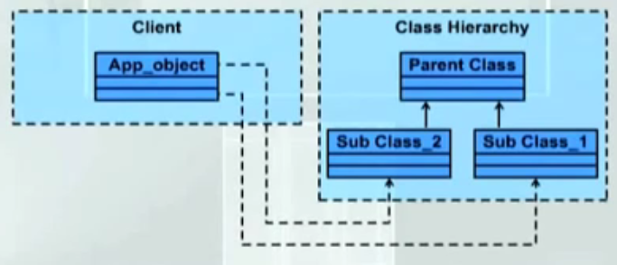
High Degree of Coupling

Slide 27
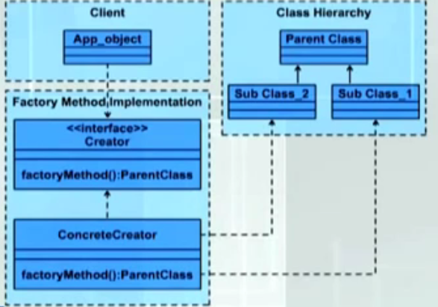
Proposed Solution

Slide 28
Proposed solution
The solution has the build violation of principle of software design i-e “Loose coupling”; as opposite to the principle above solution is having high degree of coupling between client and classes in hierarchies.

Slide 29
Problem Statement
We want the user to enter the name in either “first name last name or last name, first name” format.
We have made the assumption that there will always be a comma between last name and first name and space between first name last names.
The client does not need to be worried about which class is to access when it is entering the name in either of the format. Independent of the format of the data to be entered, system will display first name and last name.

Slide 30
Builder Design Pattern (creational pattern)

Slide 31
Builder Design Pattern
Builder is a creational design pattern that lets you construct complex objects step by step.
The pattern allows you to produce different types and representations of an object using the same construction code.

Slide 32
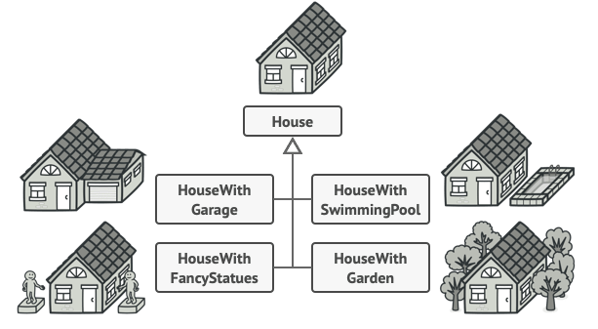
Builder Design Pattern

Slide 33
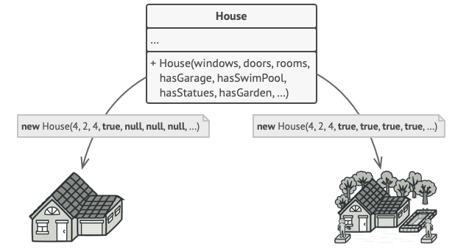
Builder Design Pattern

Slide 34
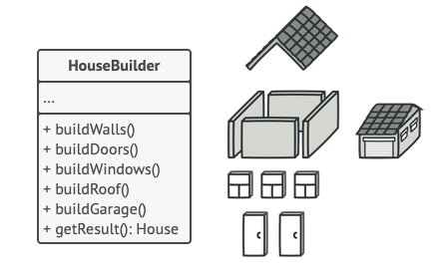
Builder Design Pattern
The Builder pattern suggests that you extract the object construction code out of its own class and move it to separate objects called builders.
The pattern organizes object construction into a set of steps (buildWalls, buildDoor, etc.).
To create an object, you execute a series of these steps on a builder object.
The important part is that you don’t need to call all of the steps.
You can call only those steps that are necessary for producing a particular configuration of an object.

Slide 35
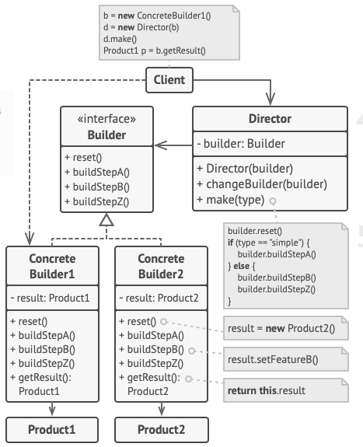
Builder Design Pattern
The Builder interface declares product construction steps that are common to all types of builders.
2. Concrete Builders provide different implementations of the construction steps. Concrete builders may produce products that don’t follow the common interface.

Slide 36
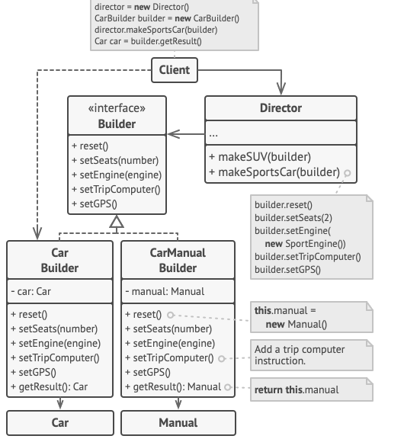
Builder Design Pattern

Slide 37
Structural Patterns
Adapter
Bridge
Composite
Decorator
Façade
Flyweight
Proxy

Slide 38
Adapter Design Pattern (structural pattern)

Slide 39
Adapter Design Pattern
Adapter is a structural design pattern that allows objects with incompatible interfaces to collaborate.

Slide 40
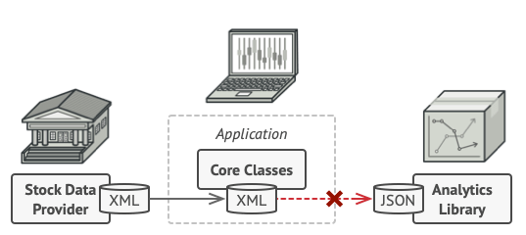
Adapter Design Pattern
Problem Statement:
Imagine that you’re creating a stock market monitoring app.
The app downloads the stock data from multiple sources in XML format and then displays nice-looking charts and diagrams for the user.
At some point, you decide to improve the app by integrating a smart 3rd-party analytics library.
But the analytics library only works with data in JSON format.
You can’t use the analytics library “as is” because it expects the data in a format that’s incompatible with your app.

Slide 41
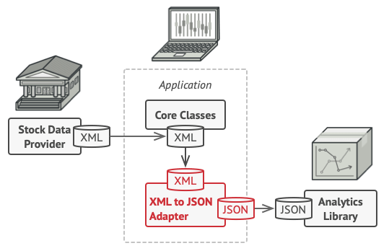
Adapter Design Pattern
Solution:
You can create an adapter. This is a special object that converts the interface of one object so that another object can understand it.
An adapter wraps one of the objects to hide the complexity of conversion happening behind the scenes.
The wrapped object isn’t even aware of the adapter. For example, you can wrap an object that operates in meters and kilometers with an adapter that converts all of the data to imperial units such as feet and miles.

Slide 42
Adapter Design Pattern
Adapters can not only convert data into various formats but can also help objects with different interfaces collaborate.
Here’s how it works:
The adapter gets an interface, compatible with one of the existing objects.
Using this interface, the existing object can safely call the adapter’s methods.
Upon receiving a call, the adapter passes the request to the second object, but in a format and order that the second object expects.

Slide 43
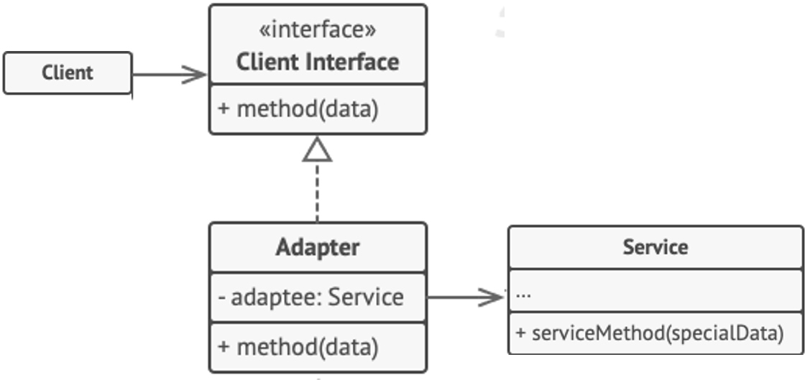
Adapter Design Pattern

Slide 44
Bridge Design Pattern (structural pattern)

Slide 45
Bridge Design Pattern
Bridge is a structural design pattern that lets you split a large class or a set of closely related classes into two separate hierarchies
abstraction and implementation
which can be developed independently of each other.

Slide 46
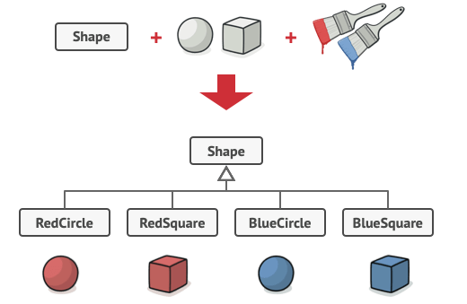
Bridge Design Pattern
Problem Statement:
Say you have a geometric Shape class with a pair of subclasses: Circle and Square.
You want to extend this class hierarchy to incorporate colors, so you plan to create Red and Blue shape subclasses.
However, since you already have two subclasses, you’ll need to create four class combinations such as BlueCircle and RedSquare.
Adding new shape types and colors to the hierarchy will grow it exponentially.
For example, to add a triangle shape you’d need to introduce two subclasses, one for each color.
And after that, adding a new color would require creating three subclasses, one for each shape type. The further we go, the worse it becomes.

Slide 47
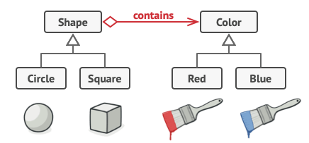
Bridge Design Pattern
Solution:
This problem occurs because we’re trying to extend the shape classes in two independent dimensions: by form and by color.
That’s a very common issue with class inheritance.
The Bridge pattern attempts to solve this problem by switching from inheritance to the object composition.
What this means is that you extract one of the dimensions into a separate class hierarchy, so that the original classes will reference an object of the new hierarchy, instead of having all of its state and behaviors within one class.

Slide 48
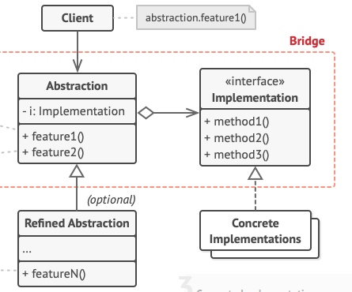
Bridge Design Pattern

Slide 49
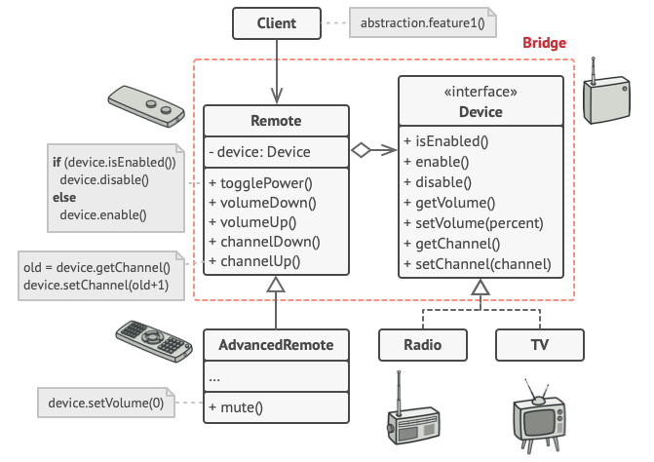
Bridge Design Pattern

Slide 50
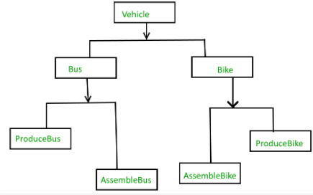
Without Bridge Design Pattern

Slide 51
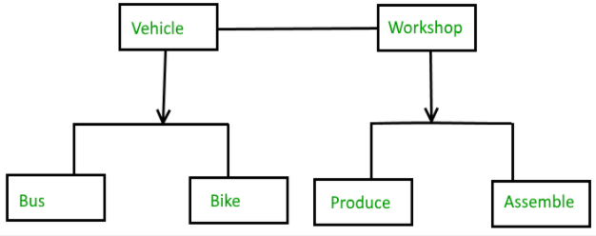
Bridge Design Pattern

Slide 52
Bridge Design Pattern
Example:
We have custom business logic to process employee data, and this processed employee data will be saved as an XML on a Windows machine and as a JSON file on a LINUX machine.
The saving part differs based on the operating system.
As per the Bridge Design Pattern, we may abstract (decouple) the business processing logic from the saving logic and it will have no knowledge of how the data will be saved.
The abstraction contains a reference (via composition) to the implementer.
The implementer class (saving of data) details will be provided during the runtime based on the operating system and both abstraction and implementer can be developed independently.

Slide 53
Proxy Design Pattern (structural pattern)

Slide 54
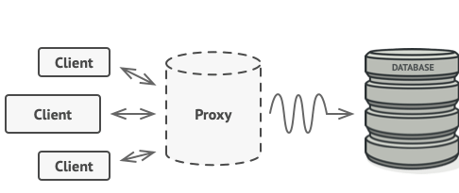
Proxy Design Pattern
Proxy is a structural design pattern that lets you provide a substitute or placeholder for another object.
A proxy controls access to the original object, allowing you to perform something either before or after the request gets through to the original object.

Slide 55
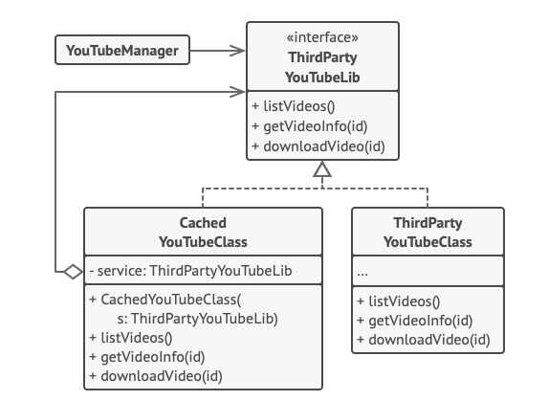
Proxy Design Pattern

Slide 56
HAVE A GOOD DAY!

